Slide 1
Course Schedule and Project Work
Prof. Dr. Dirk Riehle
Friedrich-Alexander University Erlangen-Nürnberg
AMOS A02
Licensed under CC BY 4.0 International
Notes:
It is Friedrich-Alexander University Erlangen-Nürnberg – FAU, in short.
Corporate identity wants us to say “Friedrich-Alexander University”.

Slide 2
Course Schedule
# | Class Content | Deliverables
01 | Project introductions | Team contract, T-shirt information
02 | Tools and technologies | Project information, sprint release
03 | Agile software processes | Sprint release, architecture description
04 | Agile product management | Sprint release
05 | Agile software development | Sprint release
06 | Agile quality assurance | Sprint release
07 | Agile process improvement | Sprint release
08 | Guest speaker (see online course schedule) | Mid-term release
09 | Guest speaker (see online course schedule) | Sprint release
10 | Guest speaker (see online course schedule) | Sprint release
11 | Guest speaker (see online course schedule) | Sprint release
12 | Guest speaker (see online course schedule) | Sprint release, demo day poster
13 | Guest speaker (see online course schedule) | Sprint release
14 | Guest speaker (see online course schedule) | Sprint release
15 | AMOS demo day! | Final release

Slide 3
Work Rhythm
Lectures
  Class day (90min.)
Team meetings
  Class day before or after lecture
Project work (self-organized)
  Deliverables due according to schedule

Slide 4
Types of Deliverables 1 / 4
Process artifacts
  All tabs from the planning document
  Quality criteria for process artifacts
    Cleanliness, completeness, correctness
    Understandability and usefulness
    Others more ...

Slide 5
Types of Deliverables 2 / 4
Product artifacts
  Everything in the code repository
  Product artifacts accumulate over time
    What specifically depends on the project, but typically includes
      Source code
      User documentation
      Technical documentation
  Quality criteria for product artifacts
    Cleanliness of source code
    Use of commit comments
    Effective use of branching
    Correct tags and releases
    Sufficient test coverage
    Others more …

Slide 6
Types of Deliverables 3 / 4
Stand-up emails
  A short summary email through the Happiness Index app containing
    What you did since the last email
    What problems you encountered
    What you are going to do next
  Expected minimum frequency
    Product owner role: Max. one per day, in total two per week
    Software developer role: Max one per day, in total three per week

Slide 7
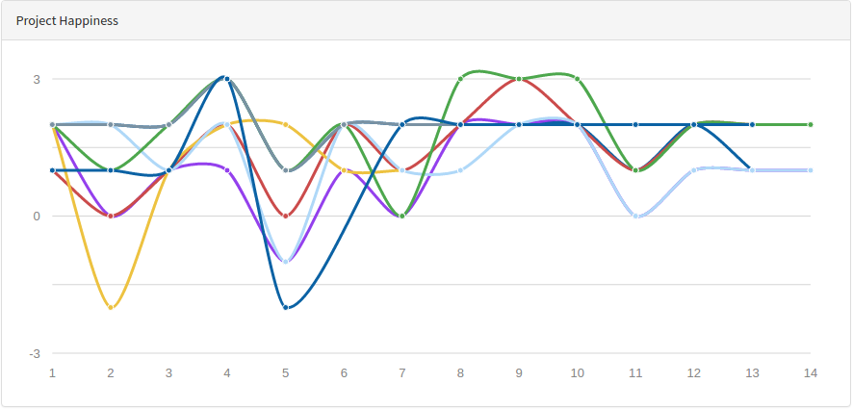
Types of Deliverables 4 / 4
Happiness index
  Provide feedback through the Happiness Index app

Slide 8
Time of Day for Deliverables
Process artifacts
  Before team meeting on team meeting day
Product artifacts
  Middle of team meeting (after prior sprint, before new sprint)
Stand-up emails
  Midnight every day
Happiness index
  During retrospective in team meeting
Everything else
  End of team meeting day

Slide 9
How to Submit Deliverables
Process artifacts
  By upload to course management system (documents)
  By email to teaching team (if no upload section exists)
Product artifacts
  By tagging on GitHub (source code)
Stand-up emails
  By using email alias or app (see Course Index)
Happiness index
  By using email alias or app (through Course Index)
Everything else
  By upload to course management system (documents)
  By email to teaching team (if no upload section exists)

Slide 10
CW #01 Deliverables Due
Provide happiness index during team meeting
Share process artifacts (with Prof. Riehle)
  Copy and adapt from http://goo.gl/Brc0Q
  Set sharing to public (viewable) so teaching team can view
Submit team contract (as PDF-scan of photo)
  More information at https://wp.me/PDU66-1su
This (first) week only: Due date/time is Friday midnight

Slide 11
CW #02 Deliverables Due
Submit information for team T-shirts
  Create logo and design your T-shirt at https://www.shirtinator.de/
  Provide T-shirt preferences (size, color) using survey through Course Index
  Put links to T-shirt designs on Shirtinator into process artifacts
Submit process artifacts (as PDF)
  Follow instructions at https://goo.gl/qoVtFA
  Plan out student roles and industry partner meetings for whole semester
Tag product artifacts on GitHub and deploy them
  Tag is sprint-01-release (continue like this in the future)
Provide stand-up emails and happiness index

Slide 12
CW #03 Deliverables Due
Submit process artifacts, include (new)
  Initial bill of materials
    Please maintain it over time
Provide product artifacts as before
Submit software architecture description (as PDF)
  High-level logical and code component overview
  Employed technology stack and platforms
Provide stand-up emails and happiness index

Slide 13
CW #04 Deliverables Due
Submit process artifacts
Provide product artifacts
Provide stand-up emails
Provide happiness index

Slide 14
CW #05 Deliverables Due
Submit process artifacts, include (new)
  Product vision and project mission
  Glossary
Provide product artifacts
Provide stand-up emails
Provide happiness index

Slide 15
CW #06 Deliverables Due
Submit process artifacts
Provide product artifacts
Provide stand-up emails
Provide happiness index

Slide 16
CW #07 Deliverables Due
Submit process artifact, include (new)
  Mid-term release plan
  Definition-of-done for both
    Sprint release
    Product release
Provide product artifact
Provide stand-up emails
Provide happiness index

Slide 17
CW #08 Deliverables Due
Submit process artifacts, include (new)
  Final product release plan
Provide product artifacts
  Mid-project product release (tagged on GitHub)
  Mid-project product documentation (tagged on GitHub)
  Mid-project product deployed as appropriate for the project
  Use additional release tag mid-project-release
Provide stand-up emails
Provide happiness index

Slide 18
CW #09 Deliverables Due
Submit process artifacts
Provide product artifacts
Provide stand-up emails
Provide happiness index

Slide 19
CW #10 Deliverables Due
Submit process artifacts
Provide product artifacts
Provide stand-up emails
Provide happiness index

Slide 20
CW #11 Deliverables Due
Submit process artifacts
Provide product artifacts
Provide stand-up emails
Provide happiness index

Slide 21
CW #12 Deliverables Due
Submit process artifacts
Provide product artifacts
Provide stand-up emails
Provide happiness index

Slide 22
CW #13 Deliverables Due
Submit AMOS demo day posters (as PDF)
  Submit high-resolution (300dpi) PDFs for DinA1 printing
  You can find examples through Course index → Student materials
  The posters will be part of your demo booth; there are two
    Product management poster, contains
      Project and team name, team logo, industry partner name, project description, use cases
    Software development poster, contains
      Software architecture, interesting technology, tooling and processes
  Please submit the PDFs as two separate files
Submit process artifacts
Provide product artifacts
Provide stand-up emails
Provide happiness index

Slide 23
CW #14 Deliverables Due
Submit process artifacts
Provide product artifacts
Provide stand-up emails
Provide happiness index

Slide 24
CW #15 Deliverables Due
Submit AMOS demo day slide (as PDF)
  Submit the night before the demo day!
Submit process artifacts in final cleaned-up version
Provide product artifacts, includes (new)
  Final product release (tagged on GitHub)
    Additional release tag is final-project-release
Provide stand-up emails
Provide happiness index

Slide 25
CW #16 Deliverables Due
Provide a project summary (by sharing with Prof. Riehle)
  Copy and fill in the form at https://goo.gl/qLiZLA
  Share with riehle@group.riehle.org
Provide a project retrospective (as PDF)
  Write down in the form of a letter to next year’s students
    What happened when?
    What went well?
    What went wrong?
    What to do better next time?
Feel free to provide feedback on the course
  Send email to appropriate person or share anonymously

Slide 26
Thank you! Questions?
dirk.riehle@fau.de – http://osr.cs.fau.de
dirk@riehle.org – http://dirkriehle.com – @dirkriehle
DR

Slide 27
Credits and License
Original version
  © 2012-2019 Dirk Riehle, some rights reserved
  Licensed under Creative Commons Attribution 4.0 International License
Contributions
  ...

